Slide 1
Photo Album
by Du Jiang

Slide 2
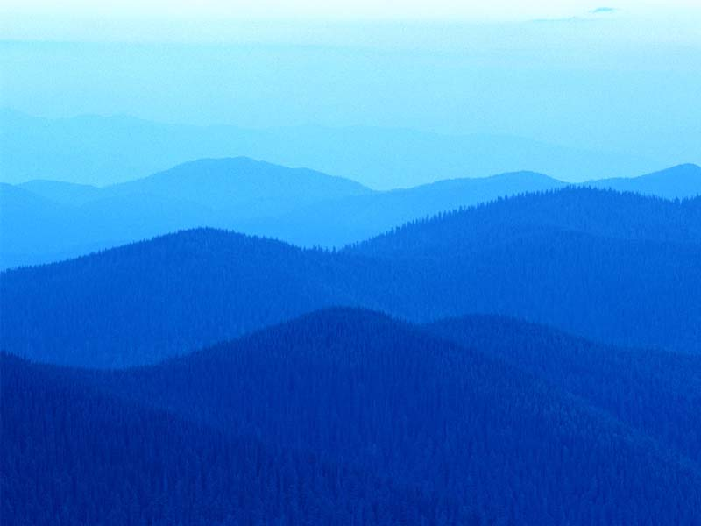
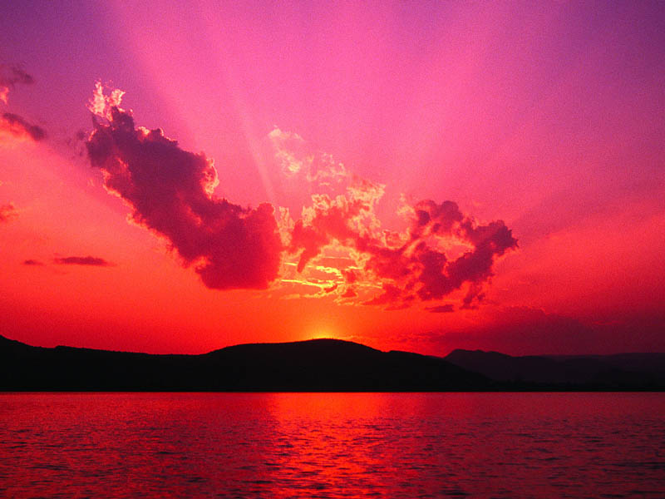
Blue hills
Sunset

Slide 3
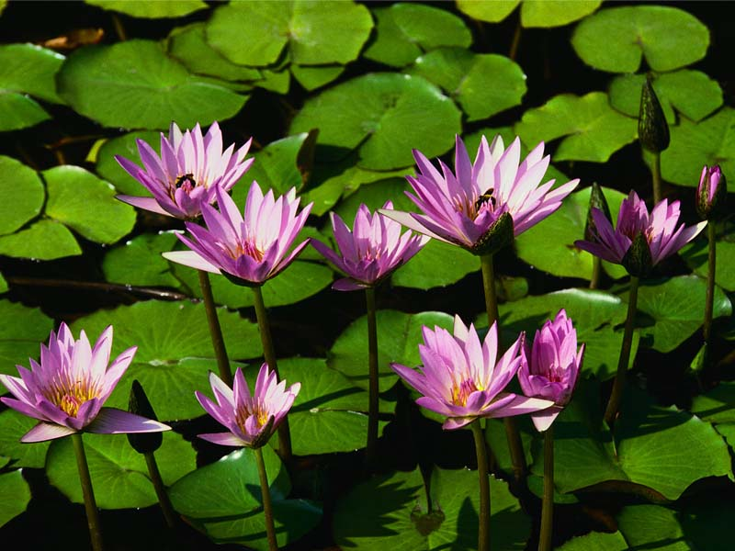
Text Box
Water lilies

Slide 4
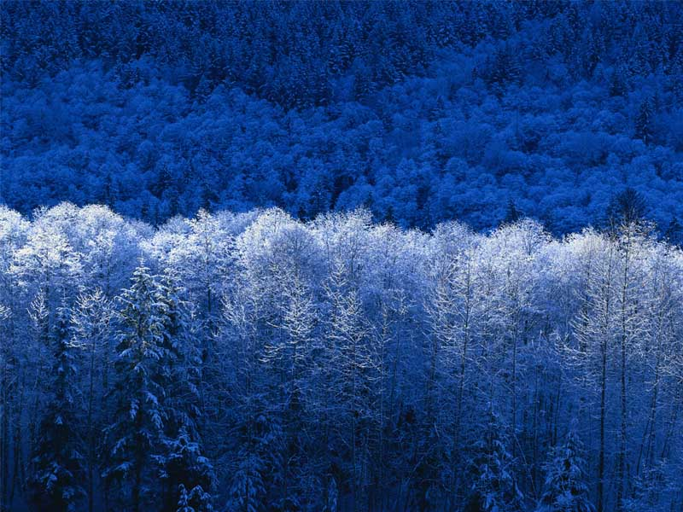
Winter

